Slide 1
Our Home in Altenbach
A Very Short Virtual Tour
By Kai

Slide 2
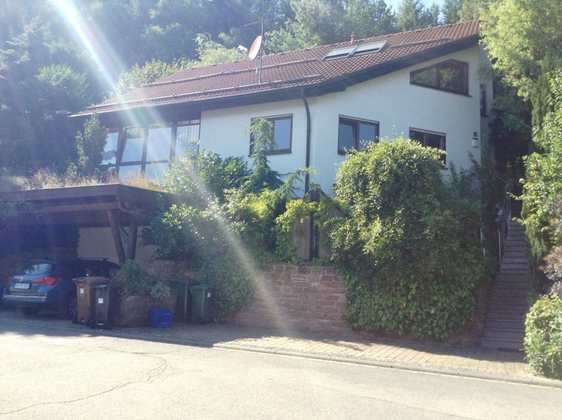
This photo shows the front of our house. Our house has three stories and a large garden. The stairs on the right lead up to the entrance. In the bottom left you can also catch a glimpse of our new car.

Slide 3
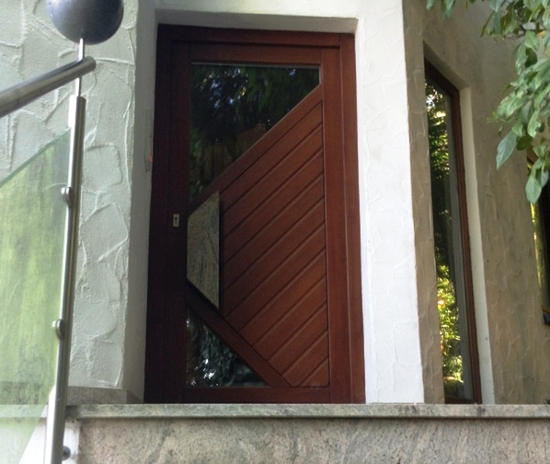
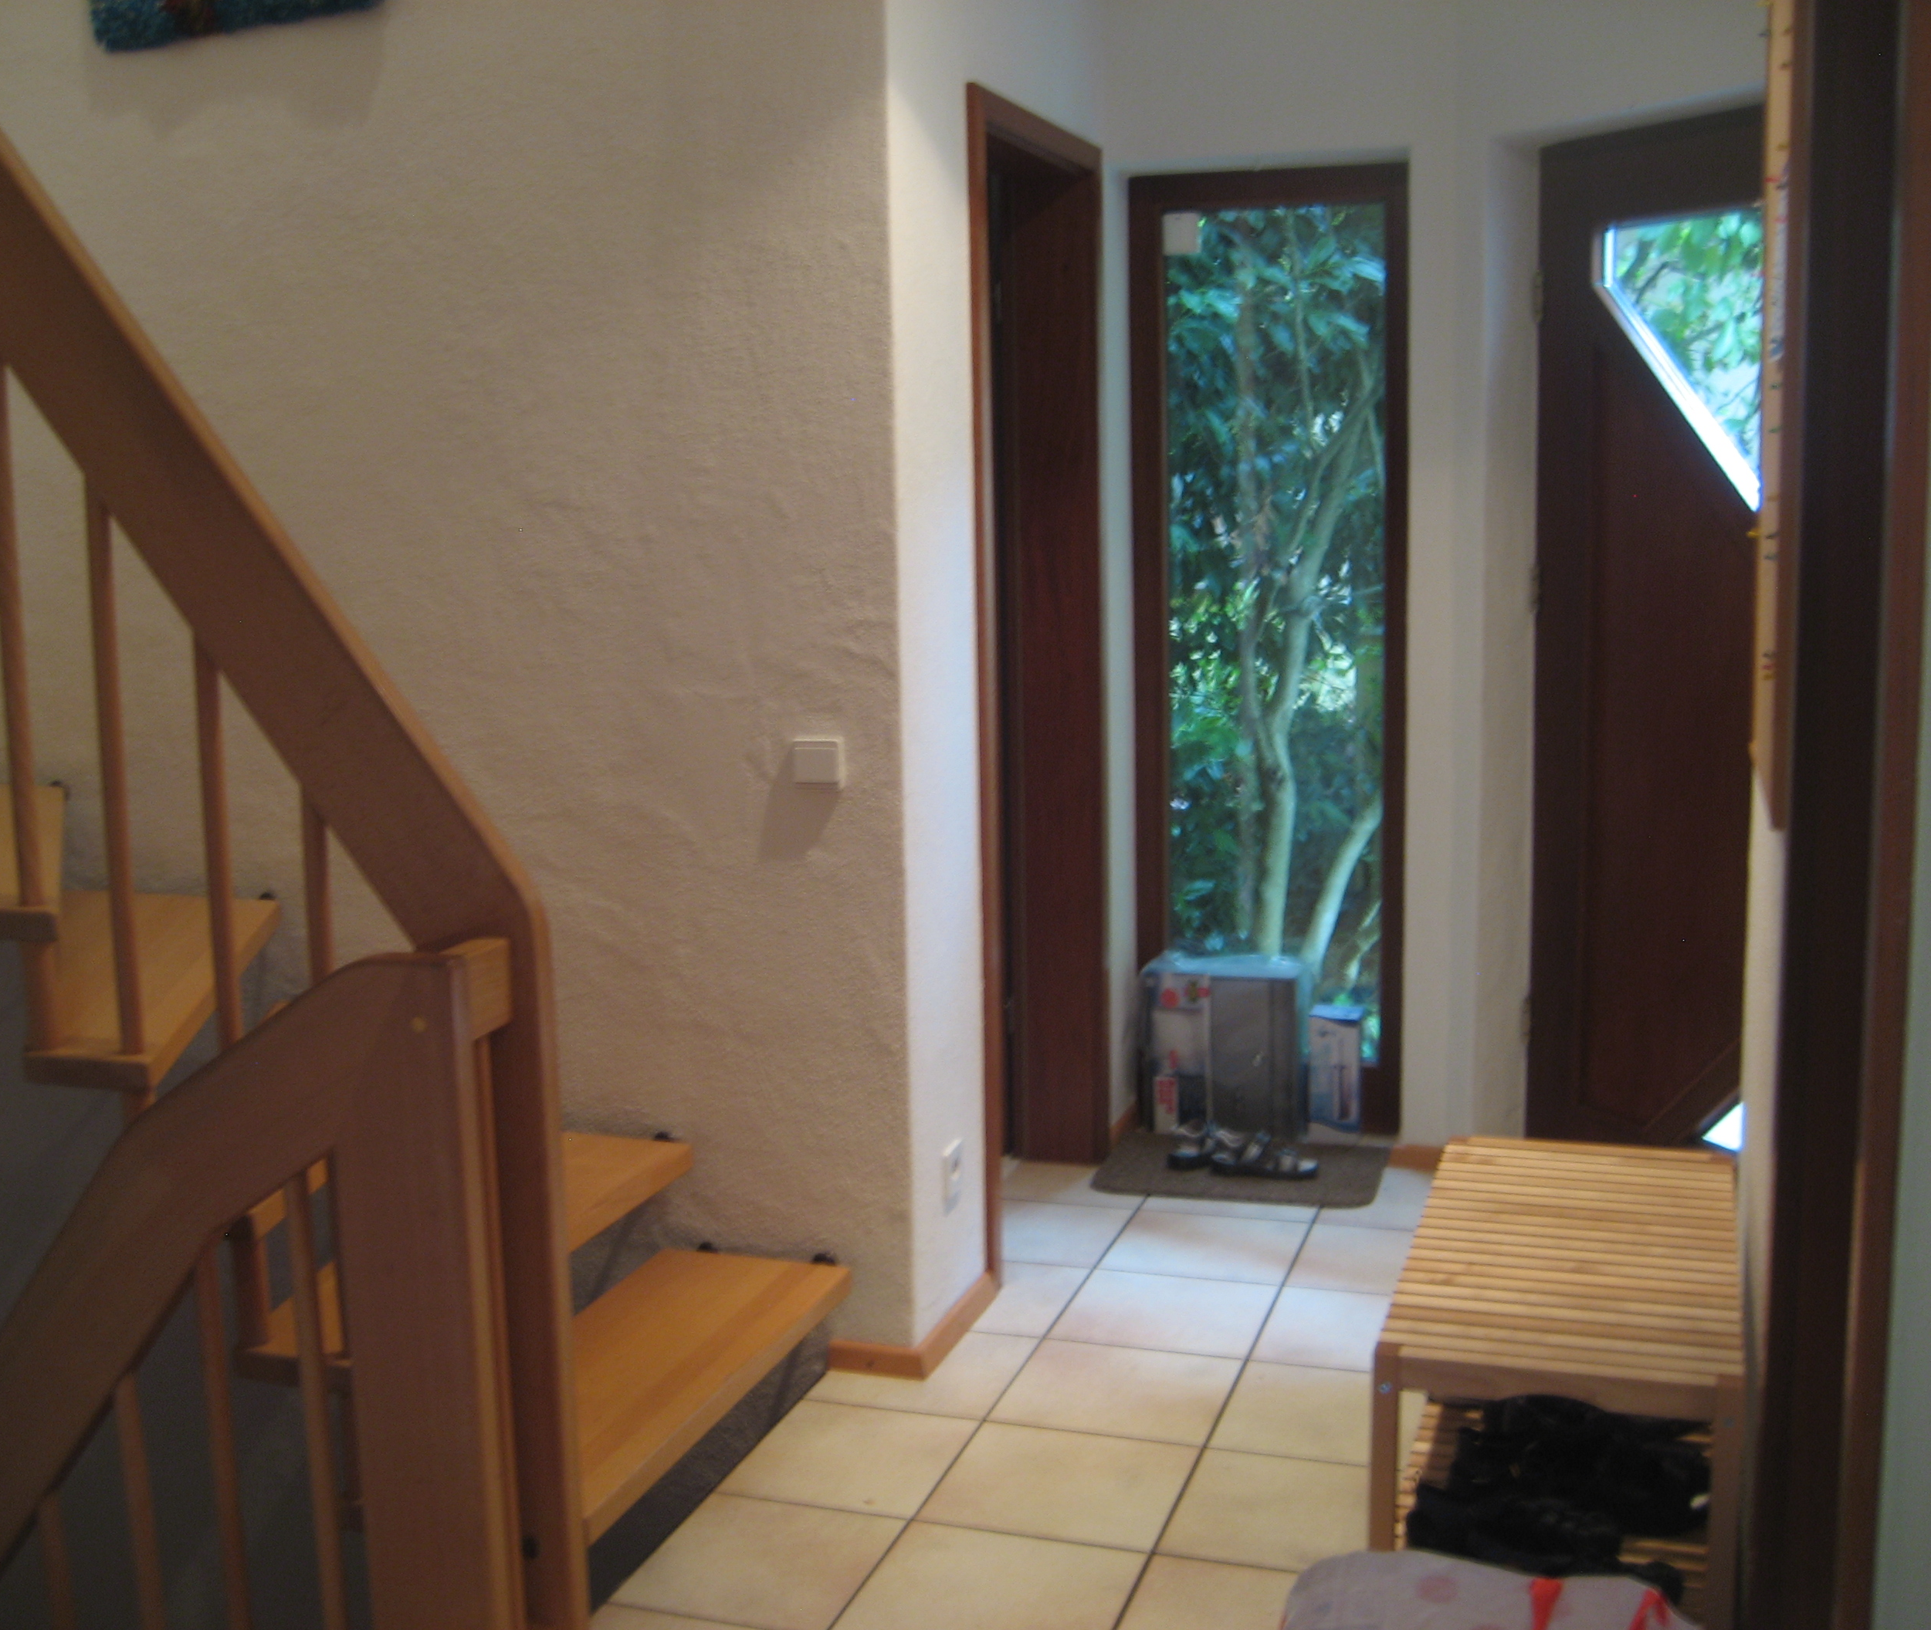
These photos show the entrance of our new home. The right photo shows part of the entrance hallway.

Slide 4
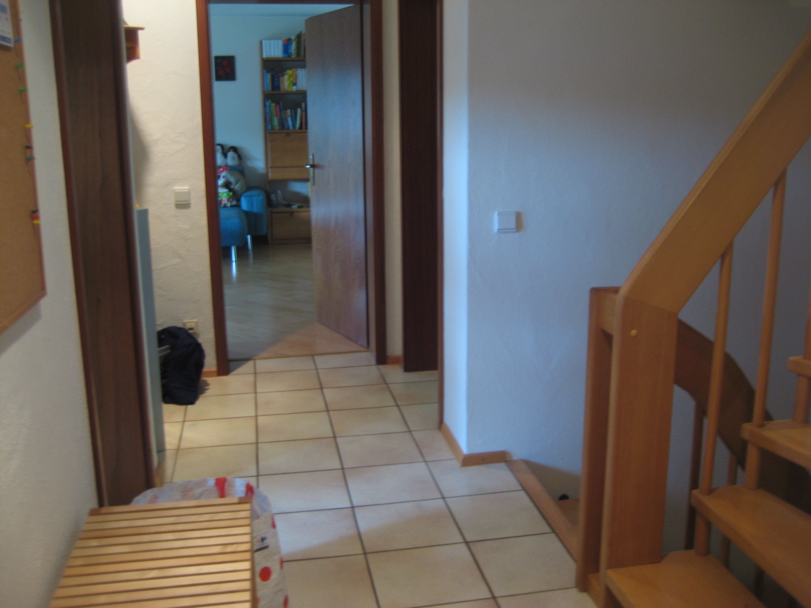
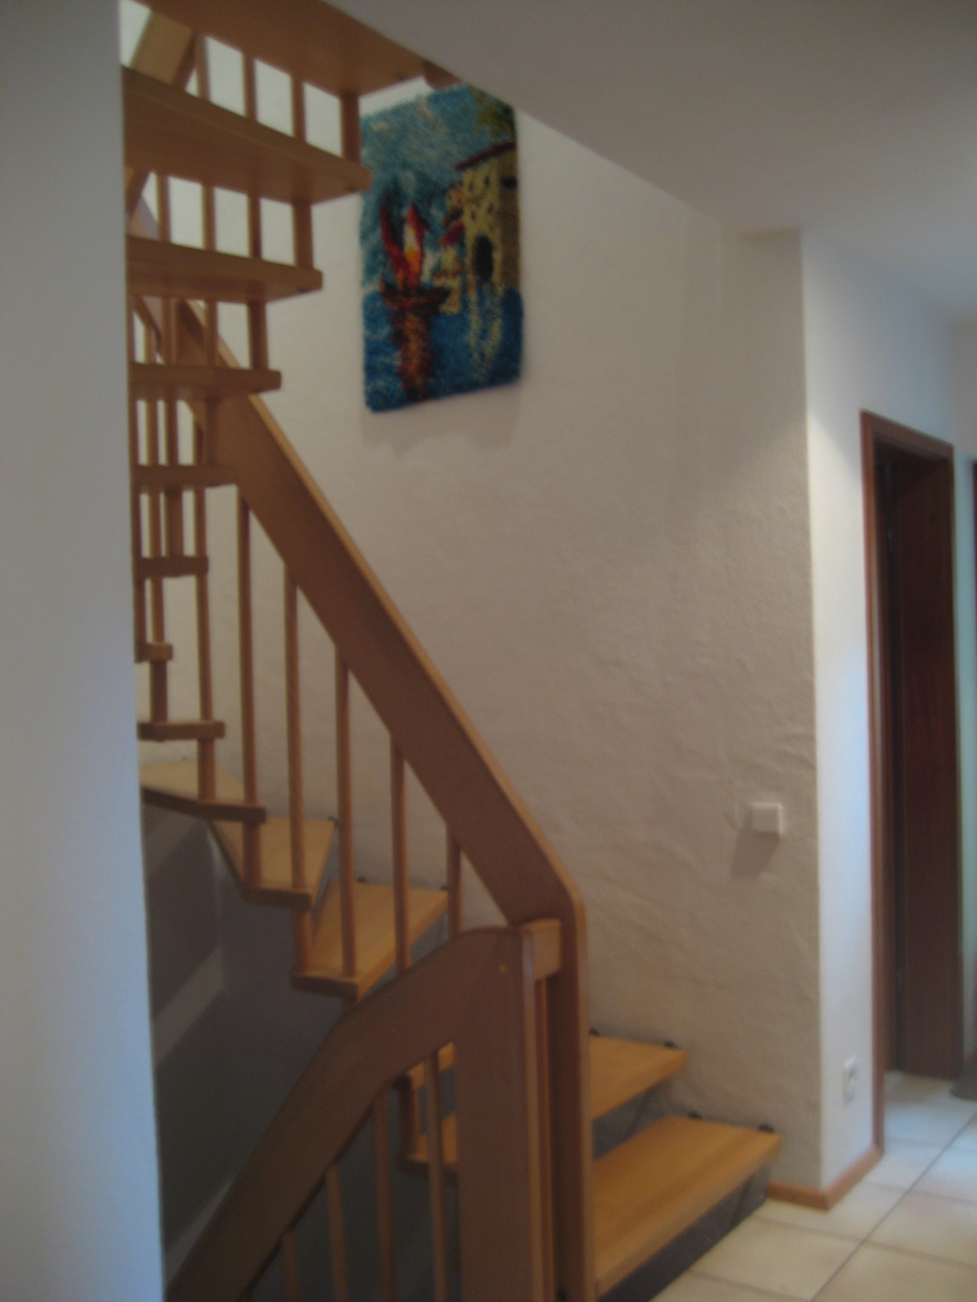
If you walk through the front door, the stairwell is located on the right. Straight ahead is the living room, and to the left is the kitchen (middle).

Slide 5
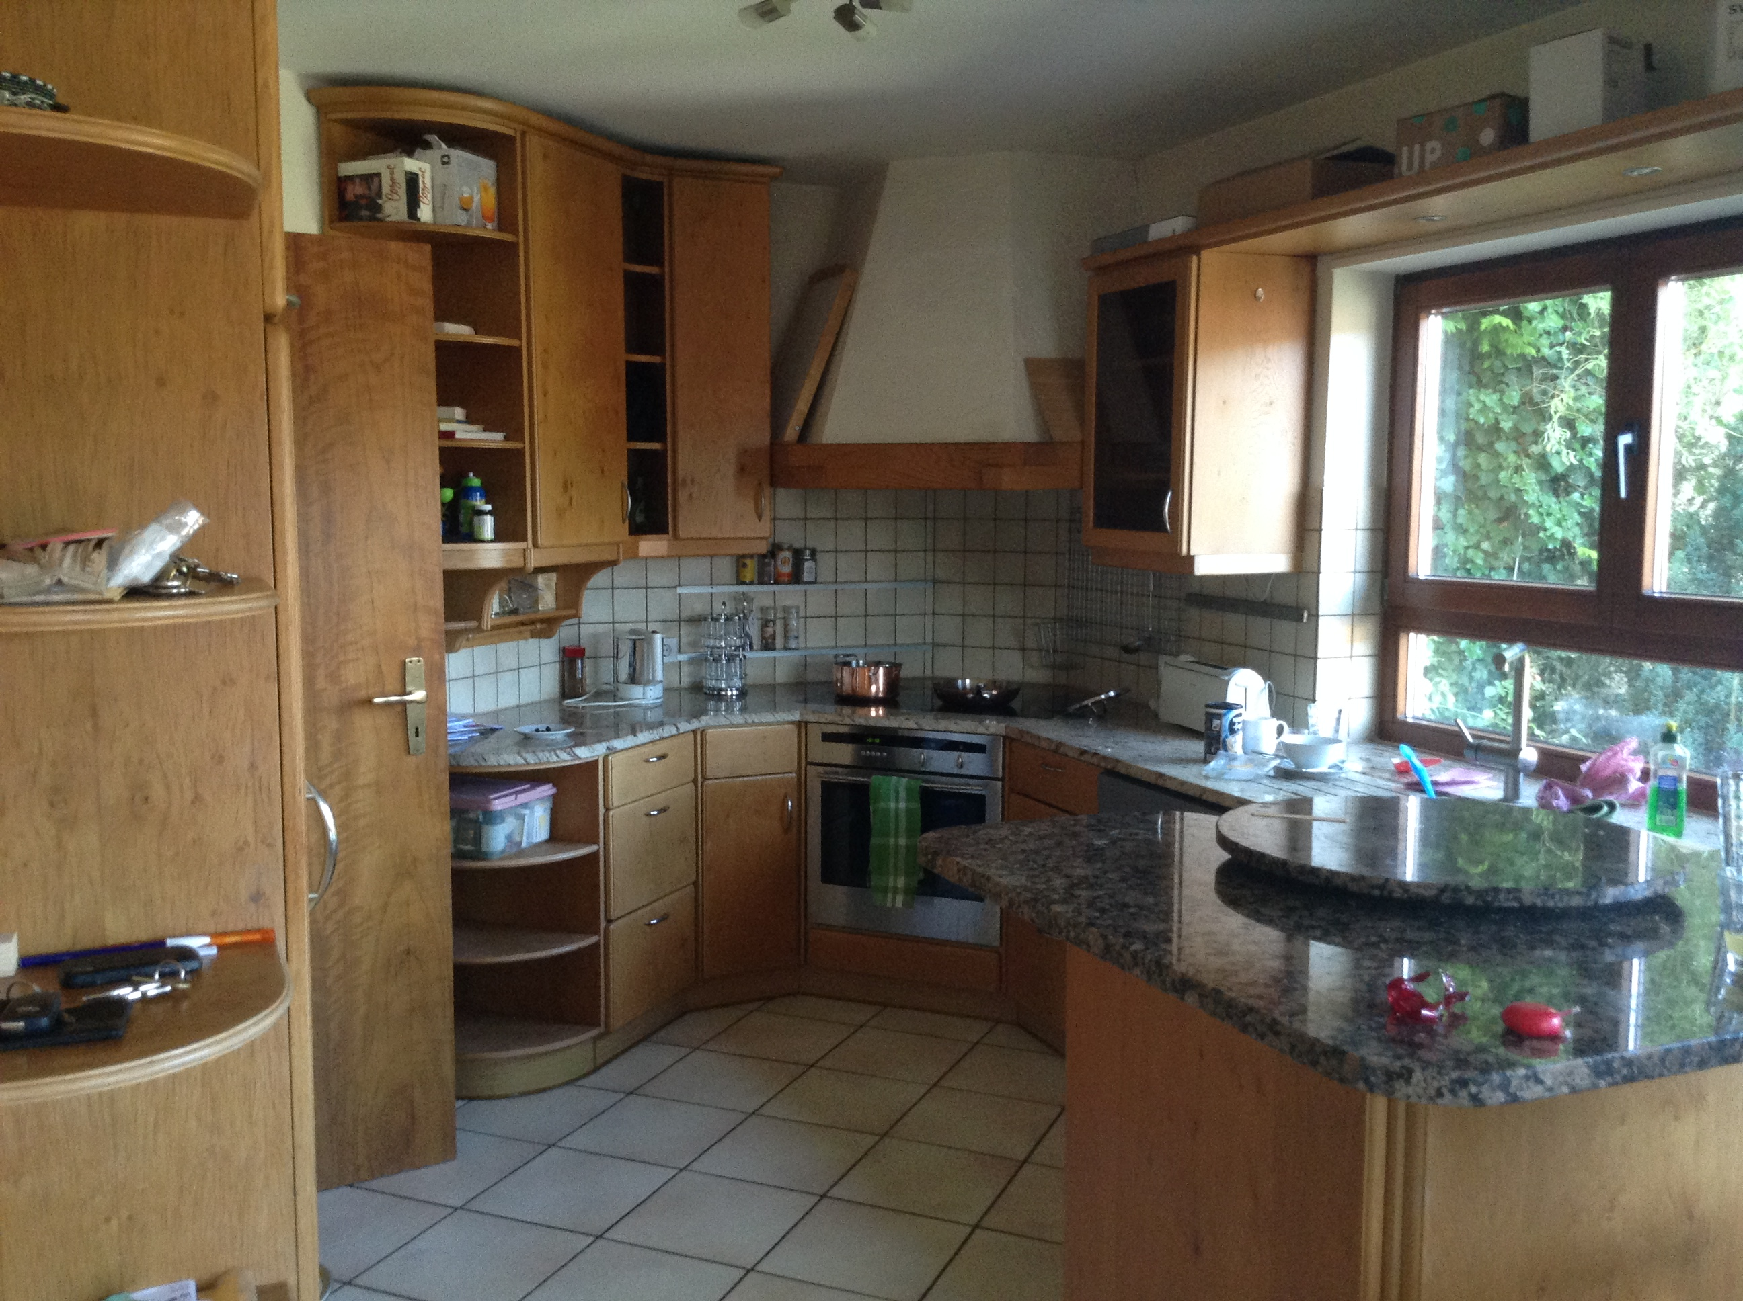
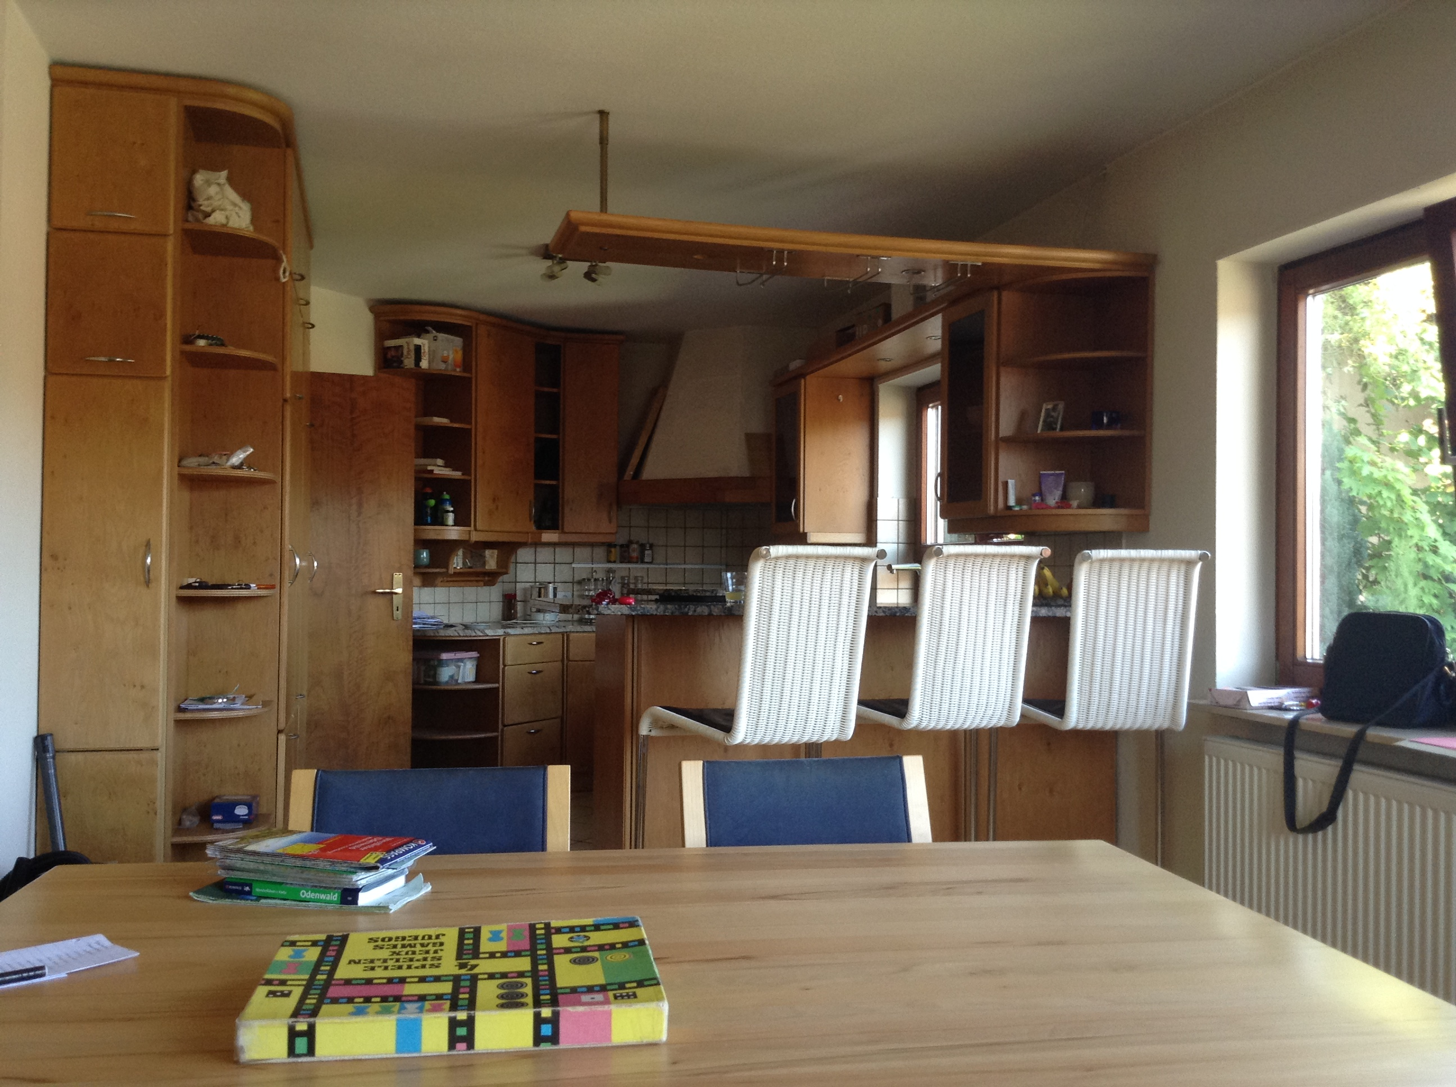
Our kitchen is the first door on the left from the entrance. It is connected to the dining room and has a bar.

Slide 6
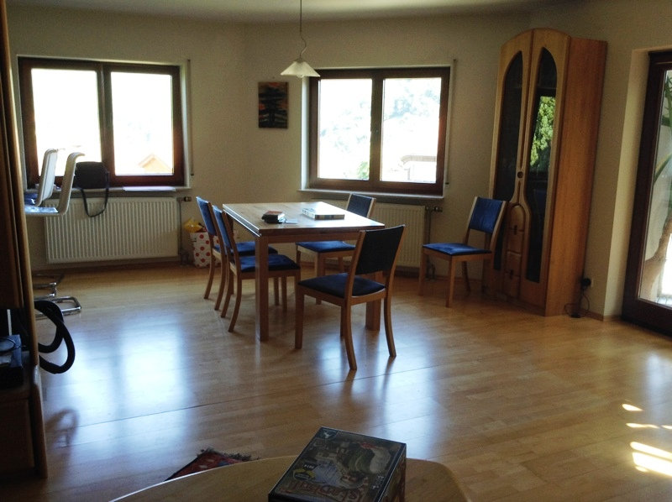
The left photo of the dining room was taken from the kitchen and shows part of the bar. The right photo more visibly portrays our new dining table.

Slide 7
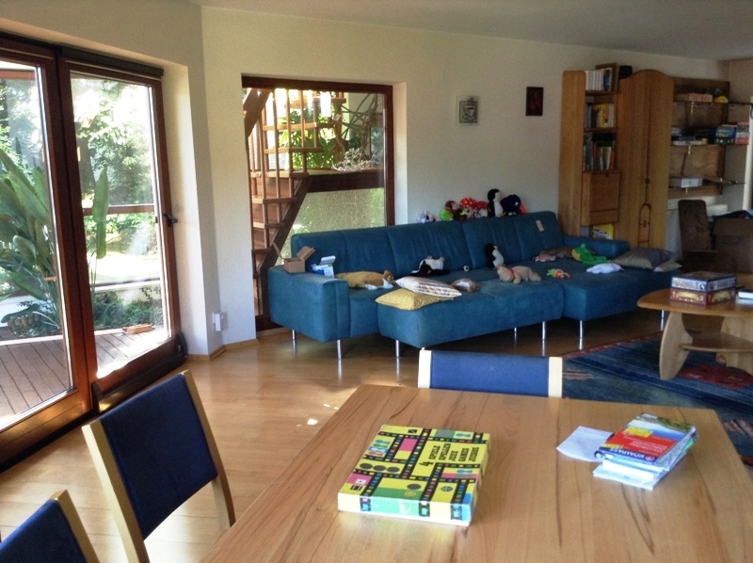
This is the family room. The glass door on the far left leads into the conservatory (which I'll get to later). The glass door in the back leads out onto the patio and into the garden. The door on the far right leads back into the entrance hallway. Eventually, I hope we'll get a piano and put it in this room next to the couch. As you can tell, Yann likes using the couch to house his stuffed animals.

Slide 8
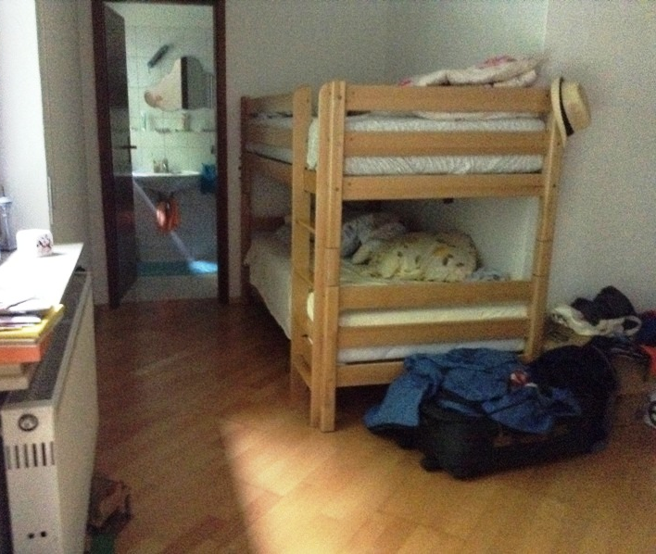
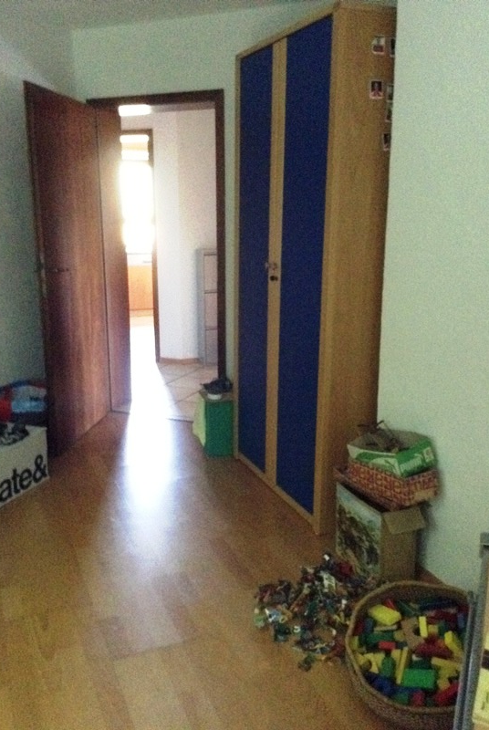
This is Yann's room. It is the last door on the right in the entrance hallway (which you can see through the door). It also has a glass door that leads into the garden. In the photo on the right, you can see the bunk bed we are sharing and the bathroom.

Slide 9
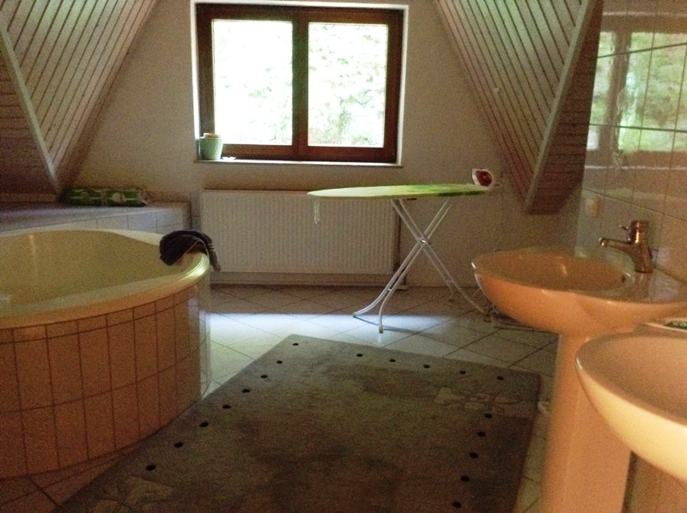
The photo on the left shows the upstairs hallway with the stairwell on the right. The glass door (with the hanging hat) straight ahead leads into the yellow room. The door on the left (next to the ladder) leads to my parents' bedroom. The door on the right leads into the bathroom shown in the photo on the right.

Slide 10
This room doubles as an office and my parents' bedroom. Through the door you can see the stairway that leads up here.

Slide 11
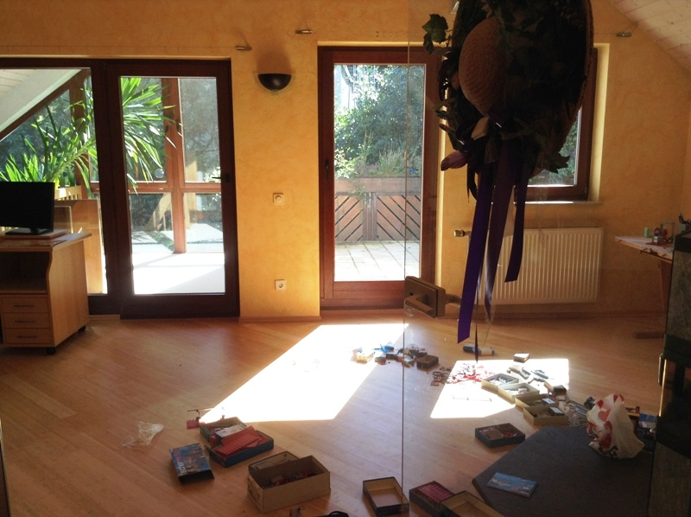
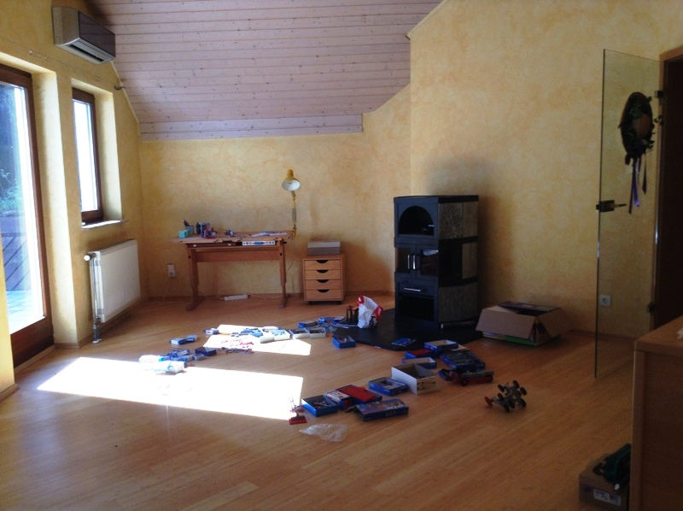
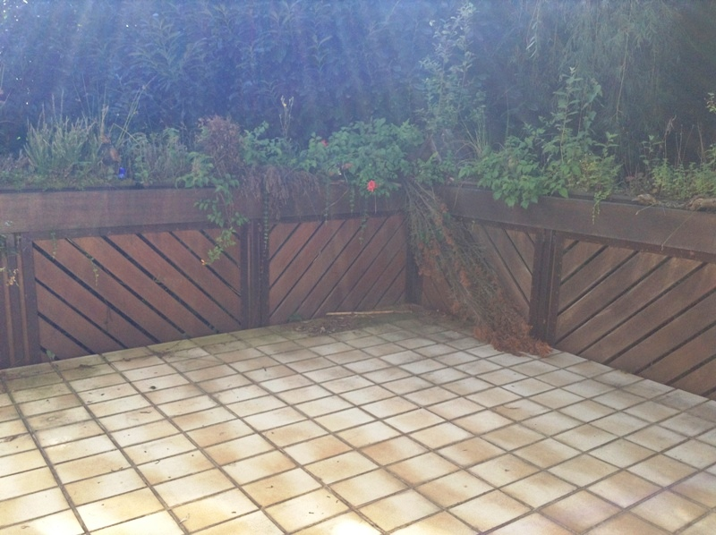
This is the what we call "the yellow room." It has air conditioning and is the number one candidate for my own room. The glass door on the left leads into the small conservatory (right).
The glass door on the right leads out to the balcony (left) which overlooks our garden.

Slide 12
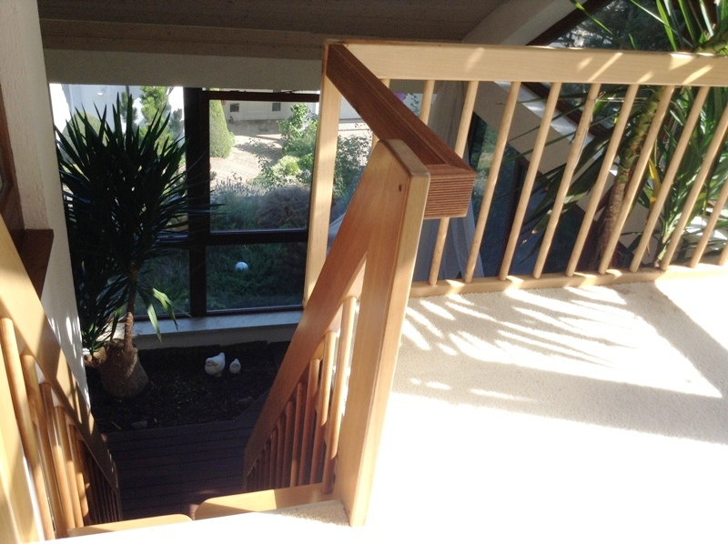
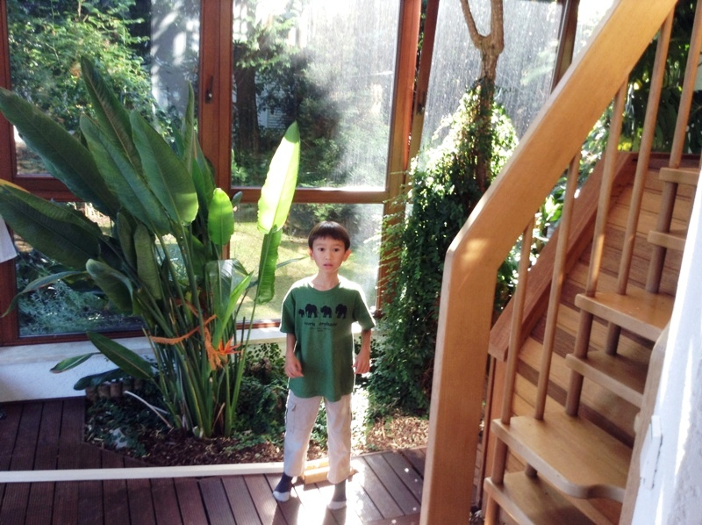
The conservatory has two entrances from inside: one through the yellow room (left) and one through the family room (as you may have seen). The lower level is where all the plants are growing. We're thinking of planting a lemon tree somewhere here.

Slide 13
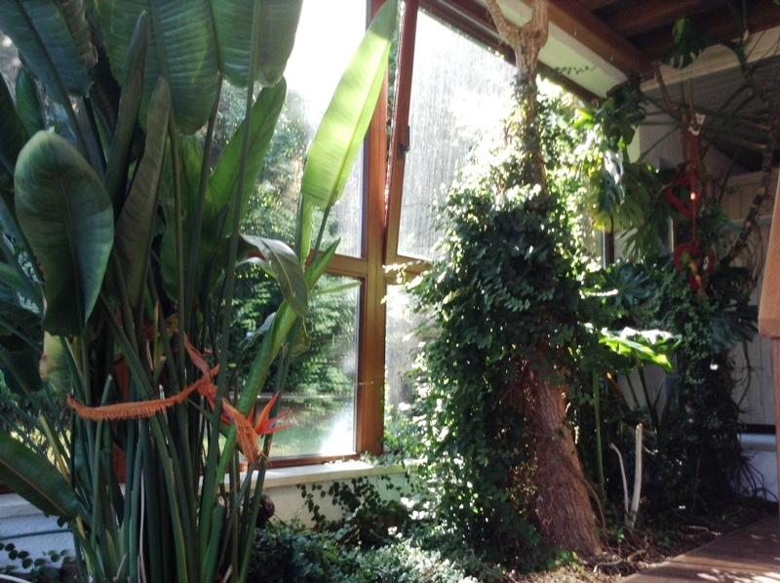
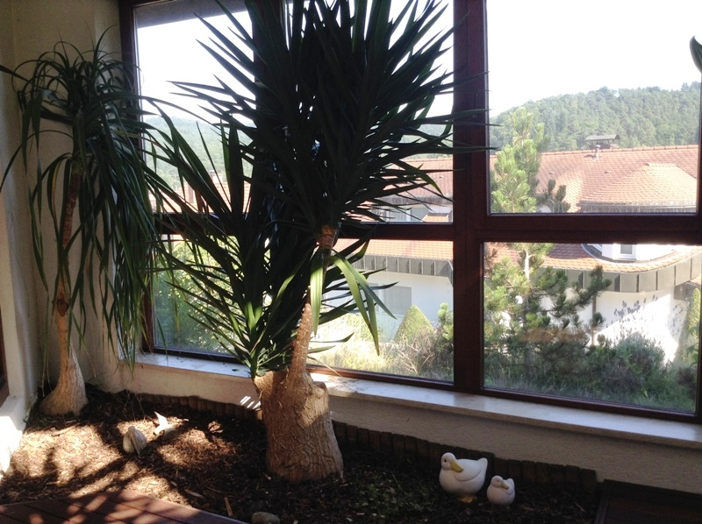
Here are more photos of the lower level. There's also a sauna in the back (upper right) and a shower that you can't quite see. In the photo on the left, you can catch a glimpse of the surrounding neighborhood.

Slide 14
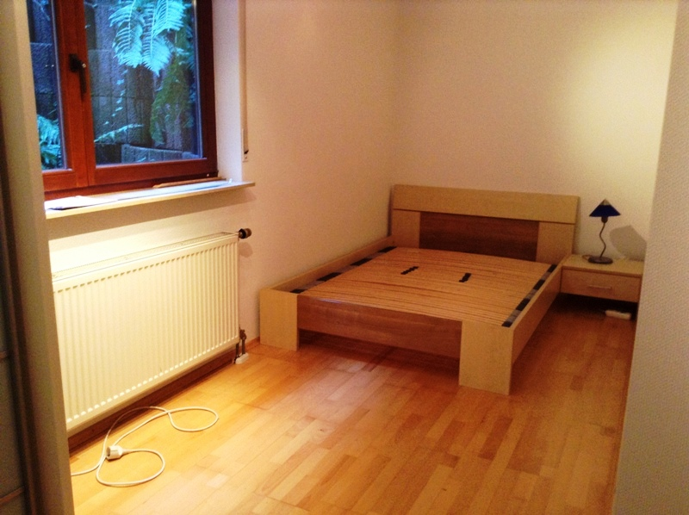
There's not much to see downstairs (a freezer, the washing machine, and the part of the house that's being rented) other than the guest room shown above. This is the other possible candidate for my room.

Slide 15
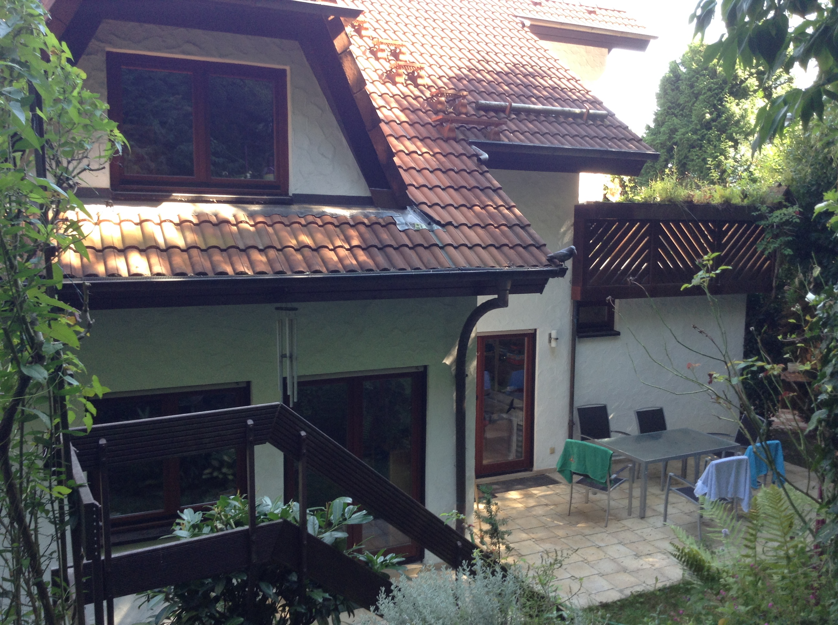
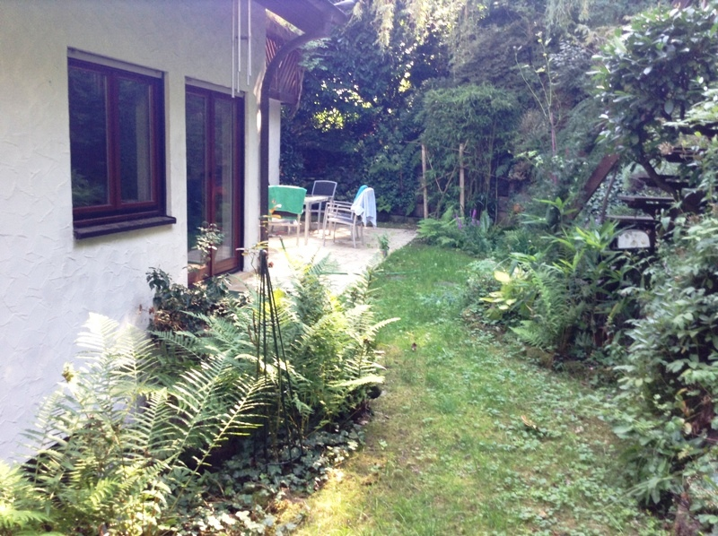
The Garden

Slide 16
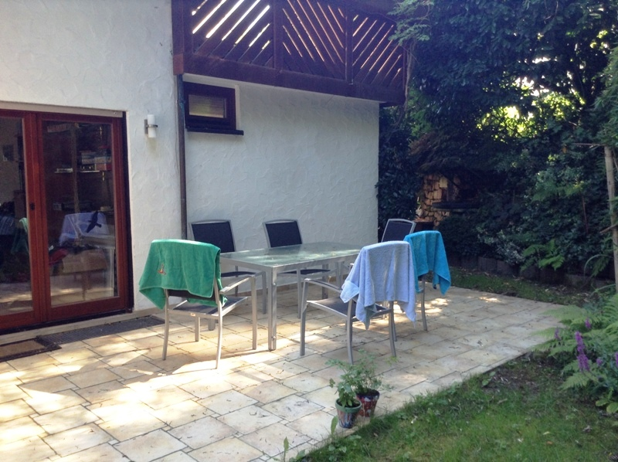
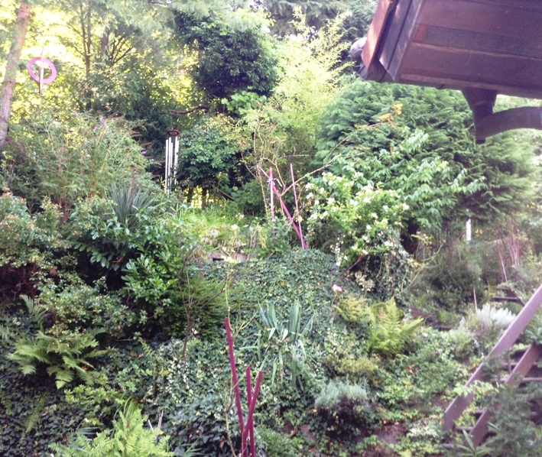
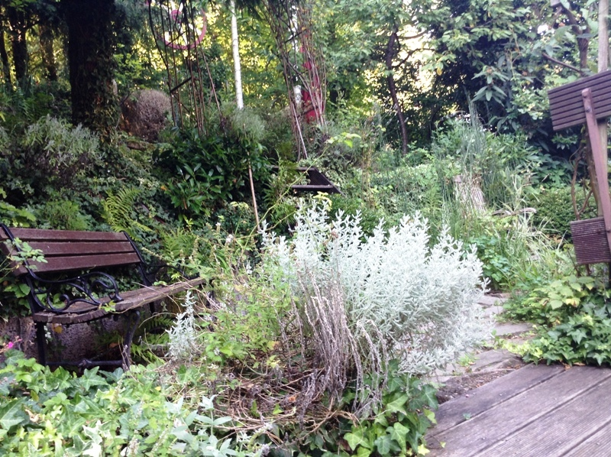
The garden is very beautiful though wild with a wide variety of plants everywhere. In the photo on the top left you can see our patio and garden table as well as the balcony above and an entrance into the living room. If you were to go around the corner you would see the small pool we have.

Slide 17
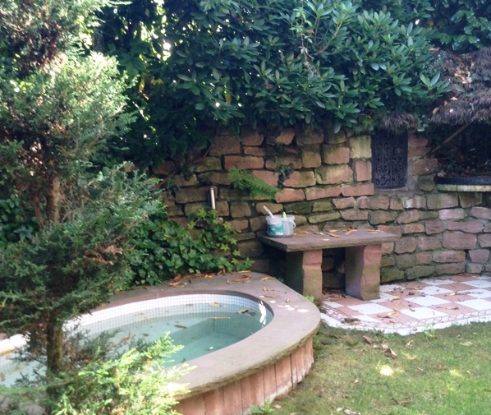
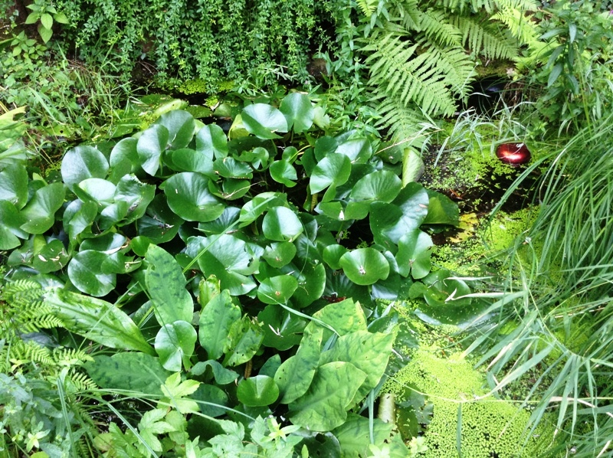
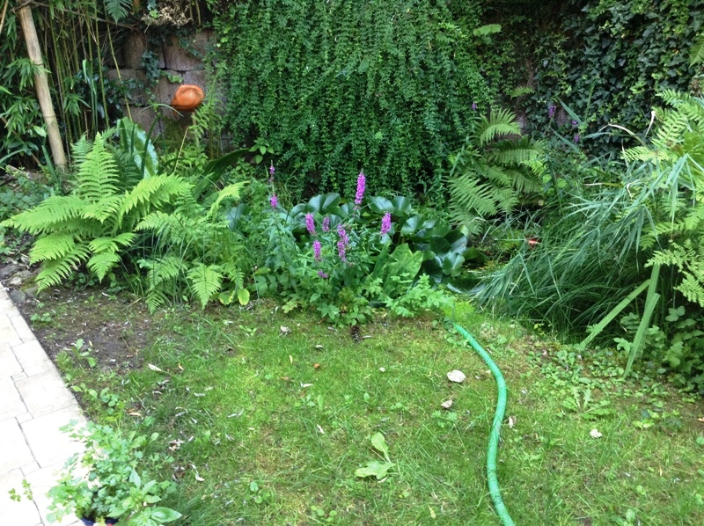
Here you can see our pond (both photos on the left), the pool (middle), and the swing (right).

Slide 18
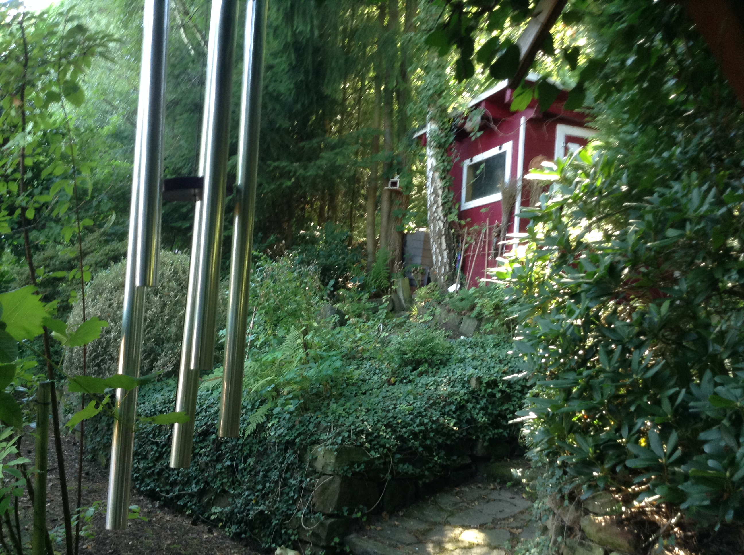
This is the meadow behind our house (left). The tree in the center is the one in which we are building our tree house. To the left is forest and to the right is our garden.

Slide 19
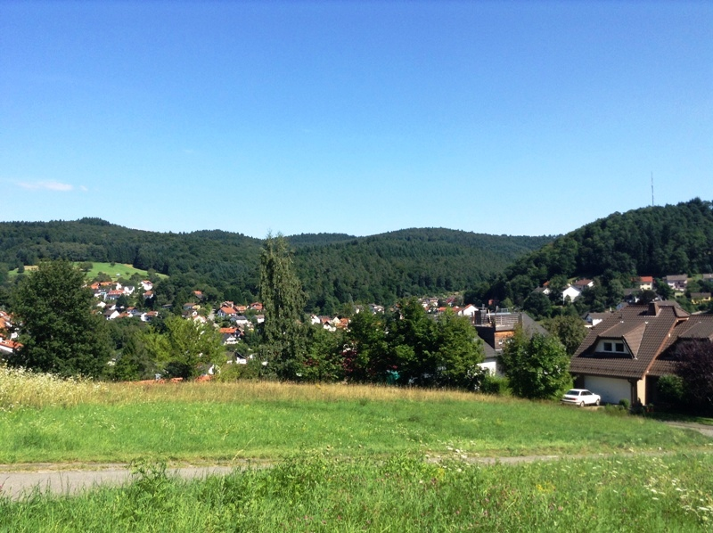
These photos show the village Altenbach. The whole area is surrounded by forest.

Slide 20
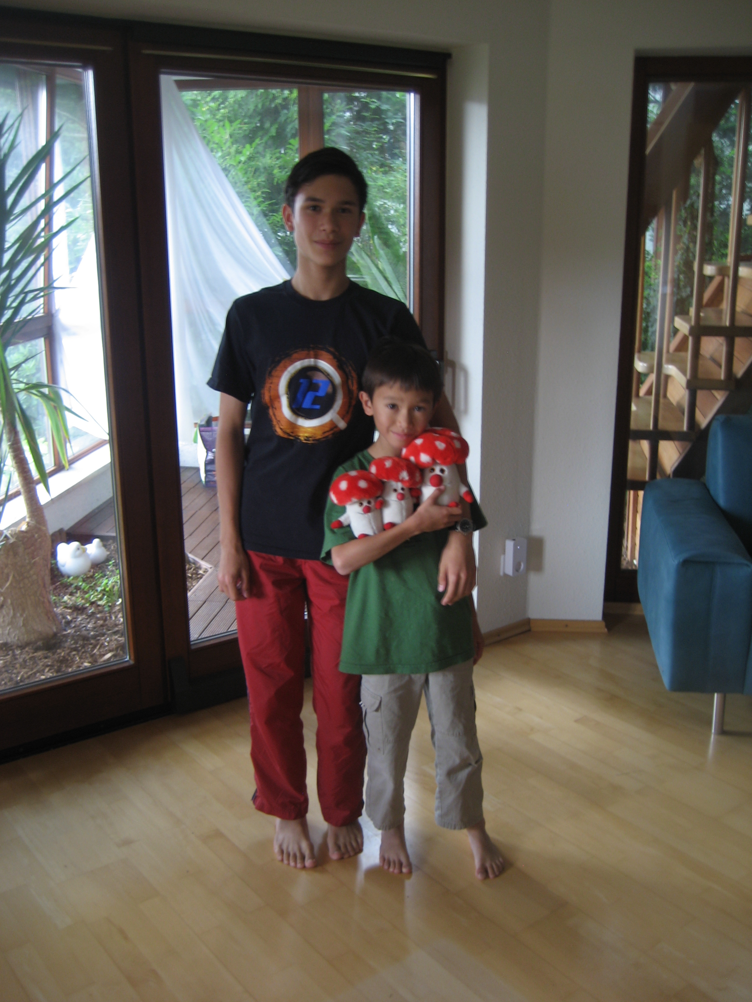
That's all for now. I know I'm not a photographer, but I hope you enjoyed!

Slide 21
Best Wishes from Altenbach!

