Slide 1
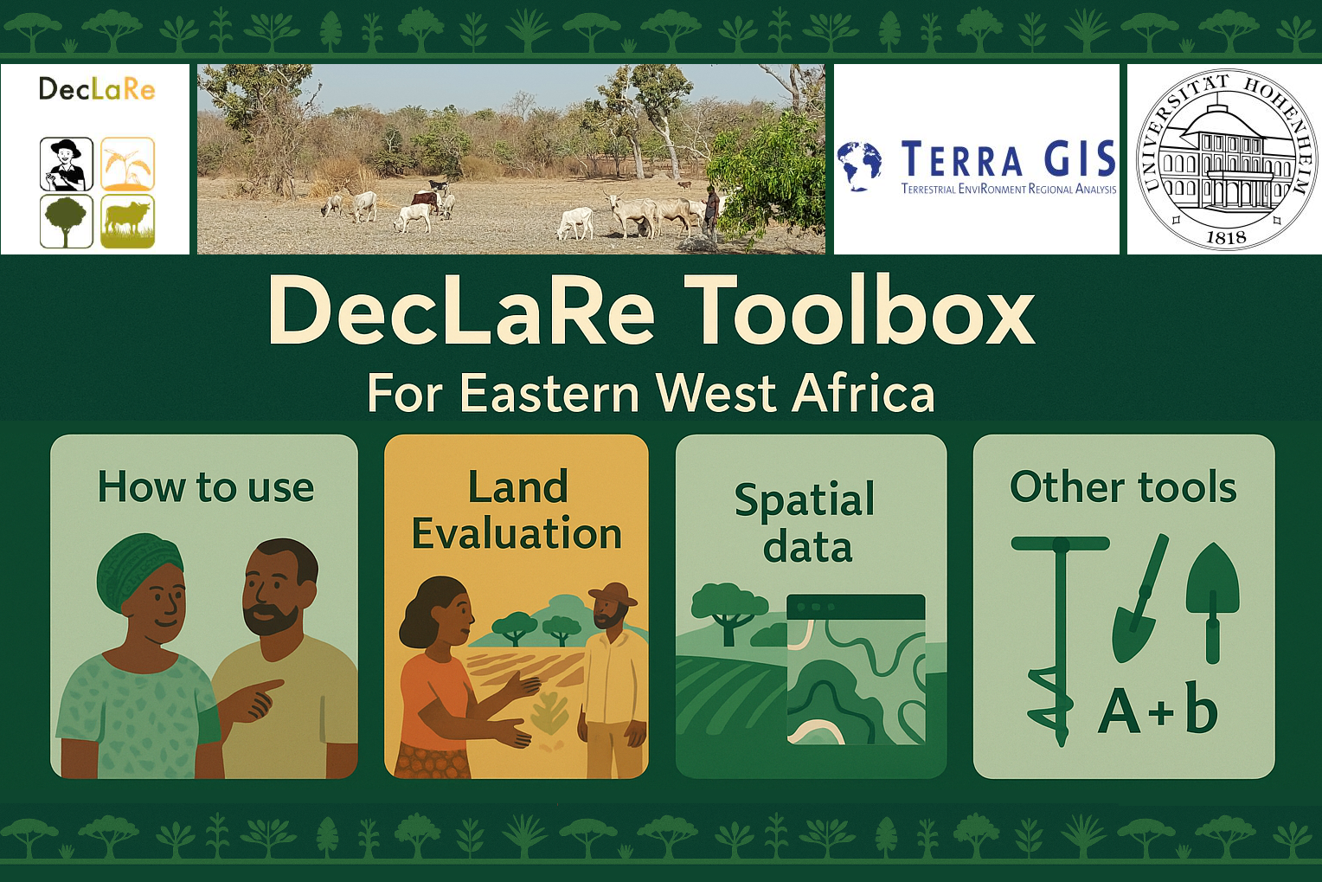
The DecLaRe DSS – Landing web page

Slide 2
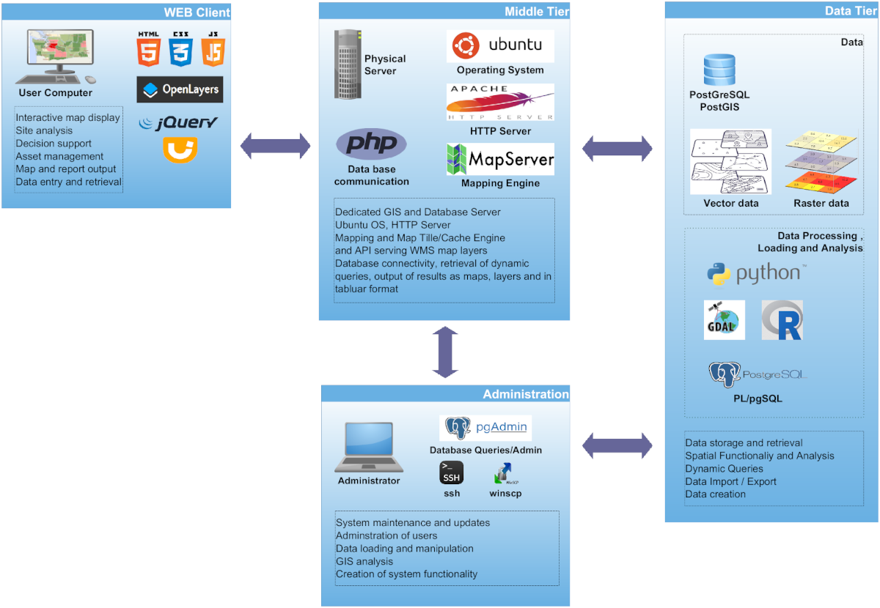
Technical Overview
The toolbox was realized based on open source software and is based on the following software stack:
OS: Ubuntu Linux
Web Server: Apache
GIS Server: MapServer
Database: PostgreSQL +
PostGIS
Libraries: PROJ,GDAL/OGR
Web: JavaScript, jQuery,
PHP, Python, OpenLayers

Slide 3
Tools
Land Evaluation Tool
  Based on the framework for land evaluation by the FAO
  Calculation of crop suitability (maize, cassava, cotton) at a scale of 250 m
  Region-specific analysis with adjustable inputs
Suitability for micro dosing application (in development)
  Evaluates site-specific fertilizer application
  Focus on smallholder farming systems
Micronutrient Chain Tool (in development)
  Identifies areas at risk of human micronutrient deficiency
  Connects geology & soil to food-chain nutrient flow
Additional Tools (open to collaboration)
  Your tool here …

Slide 4
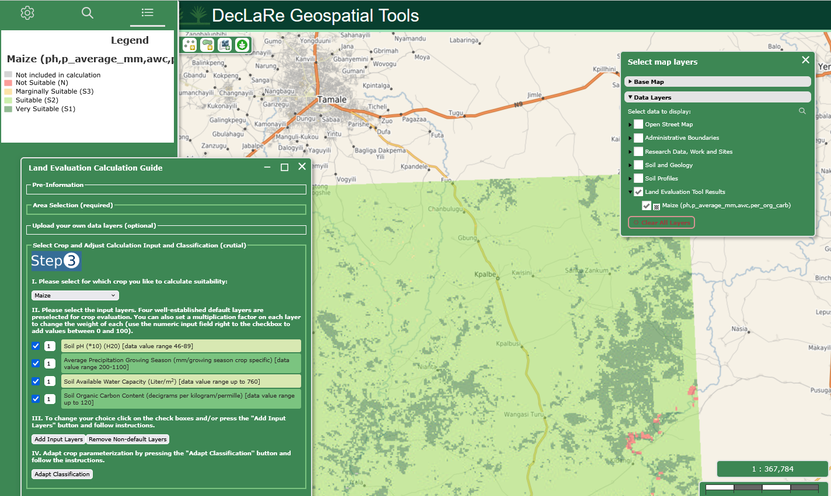
Land Evaluation Tool
Land Evaluation Tool
Based on the framework for land evaluation by the FAO
Calculation of crop suitability (maize, cassava, cotton) at a scale of 250 m
Region-specific analysis with adjustable inputs

Slide 5
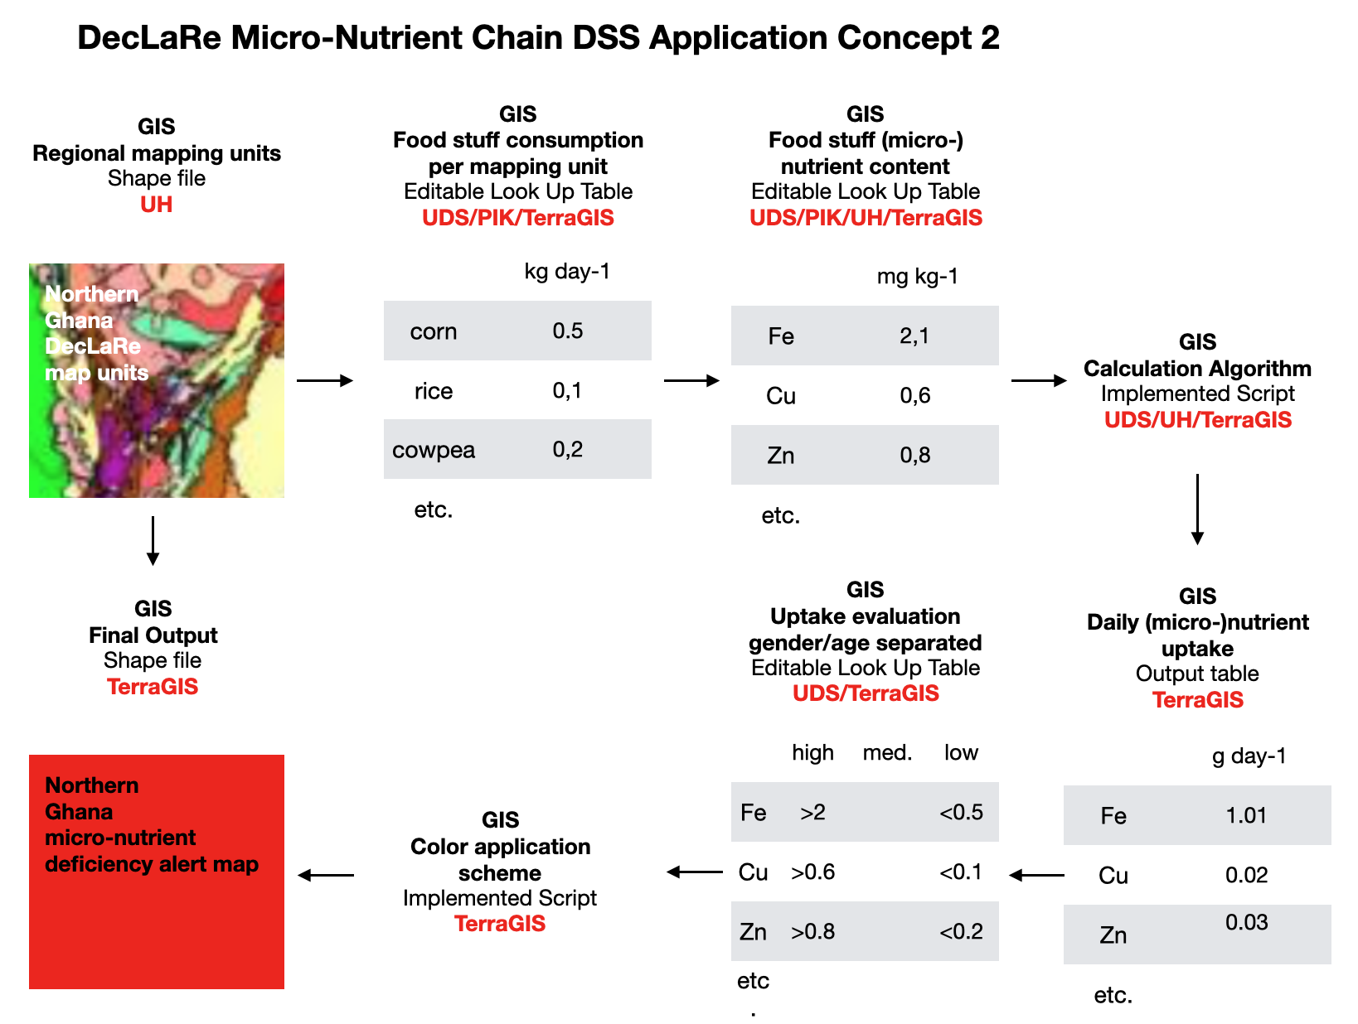
Tools
Micronutrient Chain Tool (in development)
  Identifies areas at risk of human micronutrient deficiency
  Connects geology & soil to food-chain nutrient flow

Slide 6
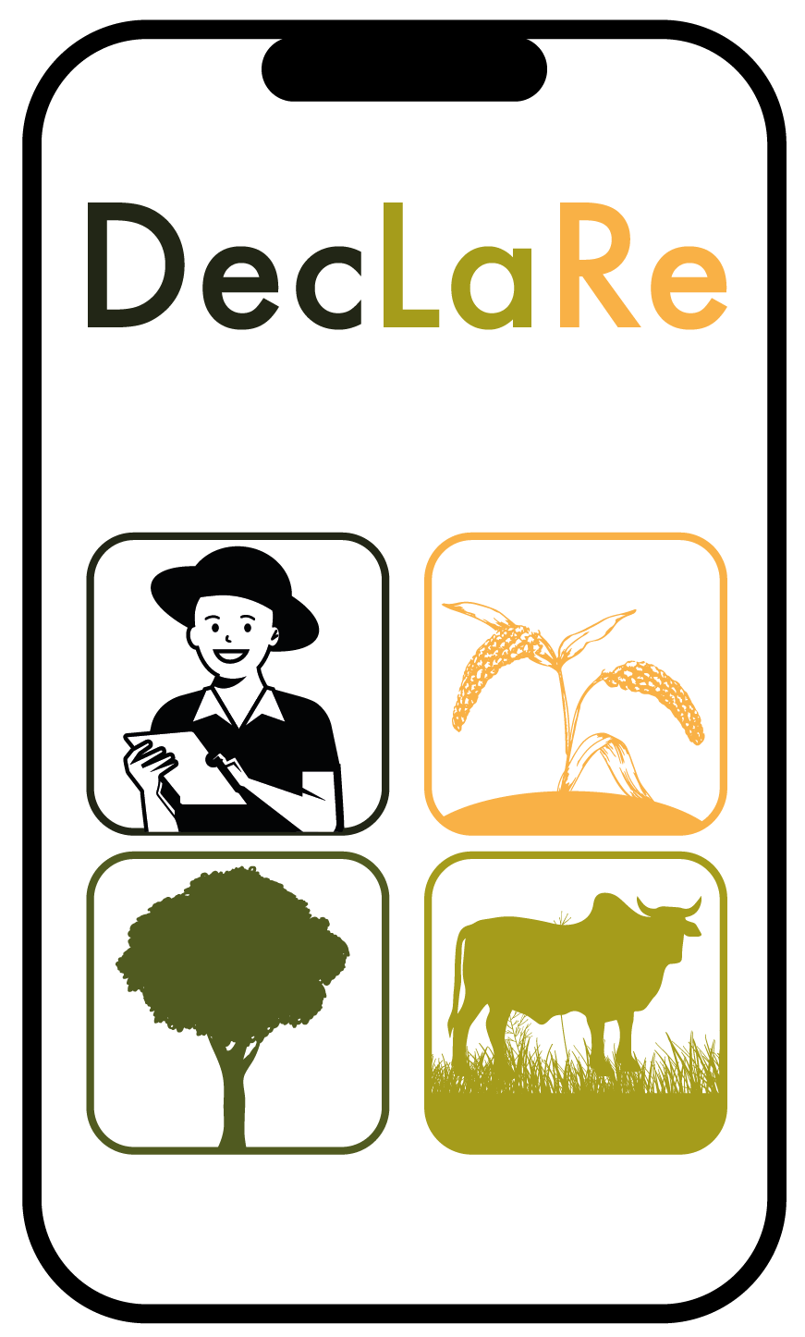
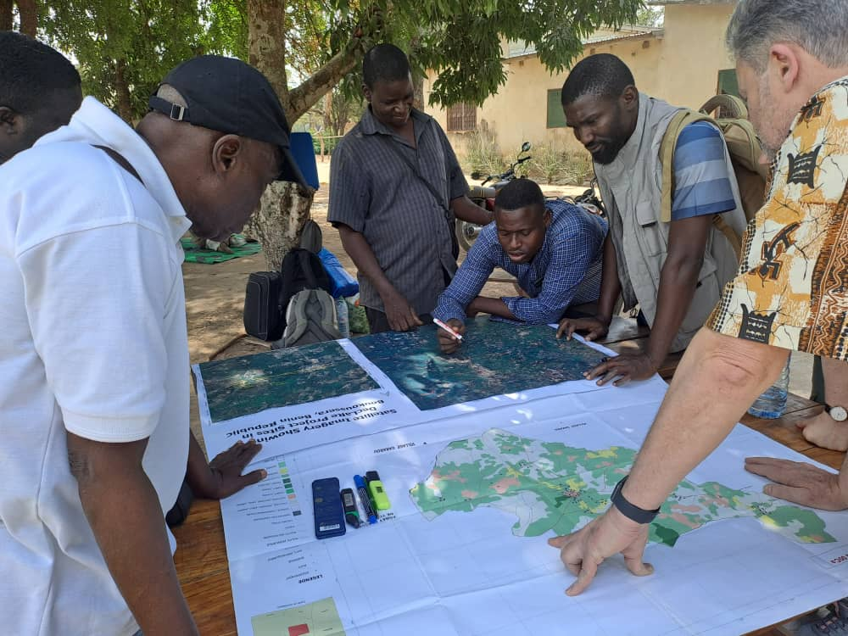
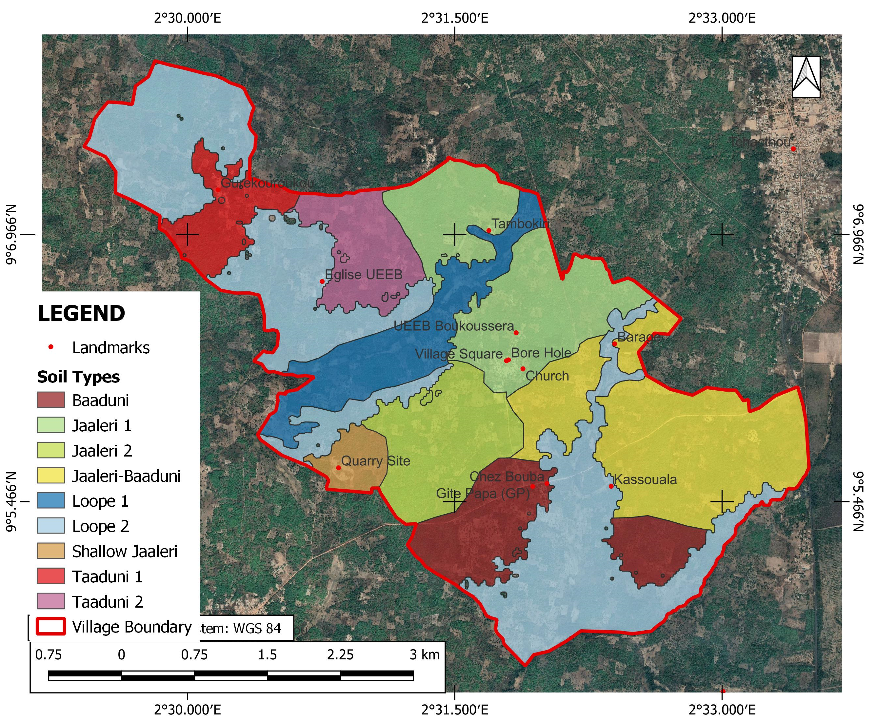
Participatory soil mapping aided by gamma spectroscopy
Participatory Soil Mapping Process
Preliminary Soil Map of Boukoussera
The participatory approach helps to bridge the language/knowledge divide between rural farmers and researchers

Slide 7
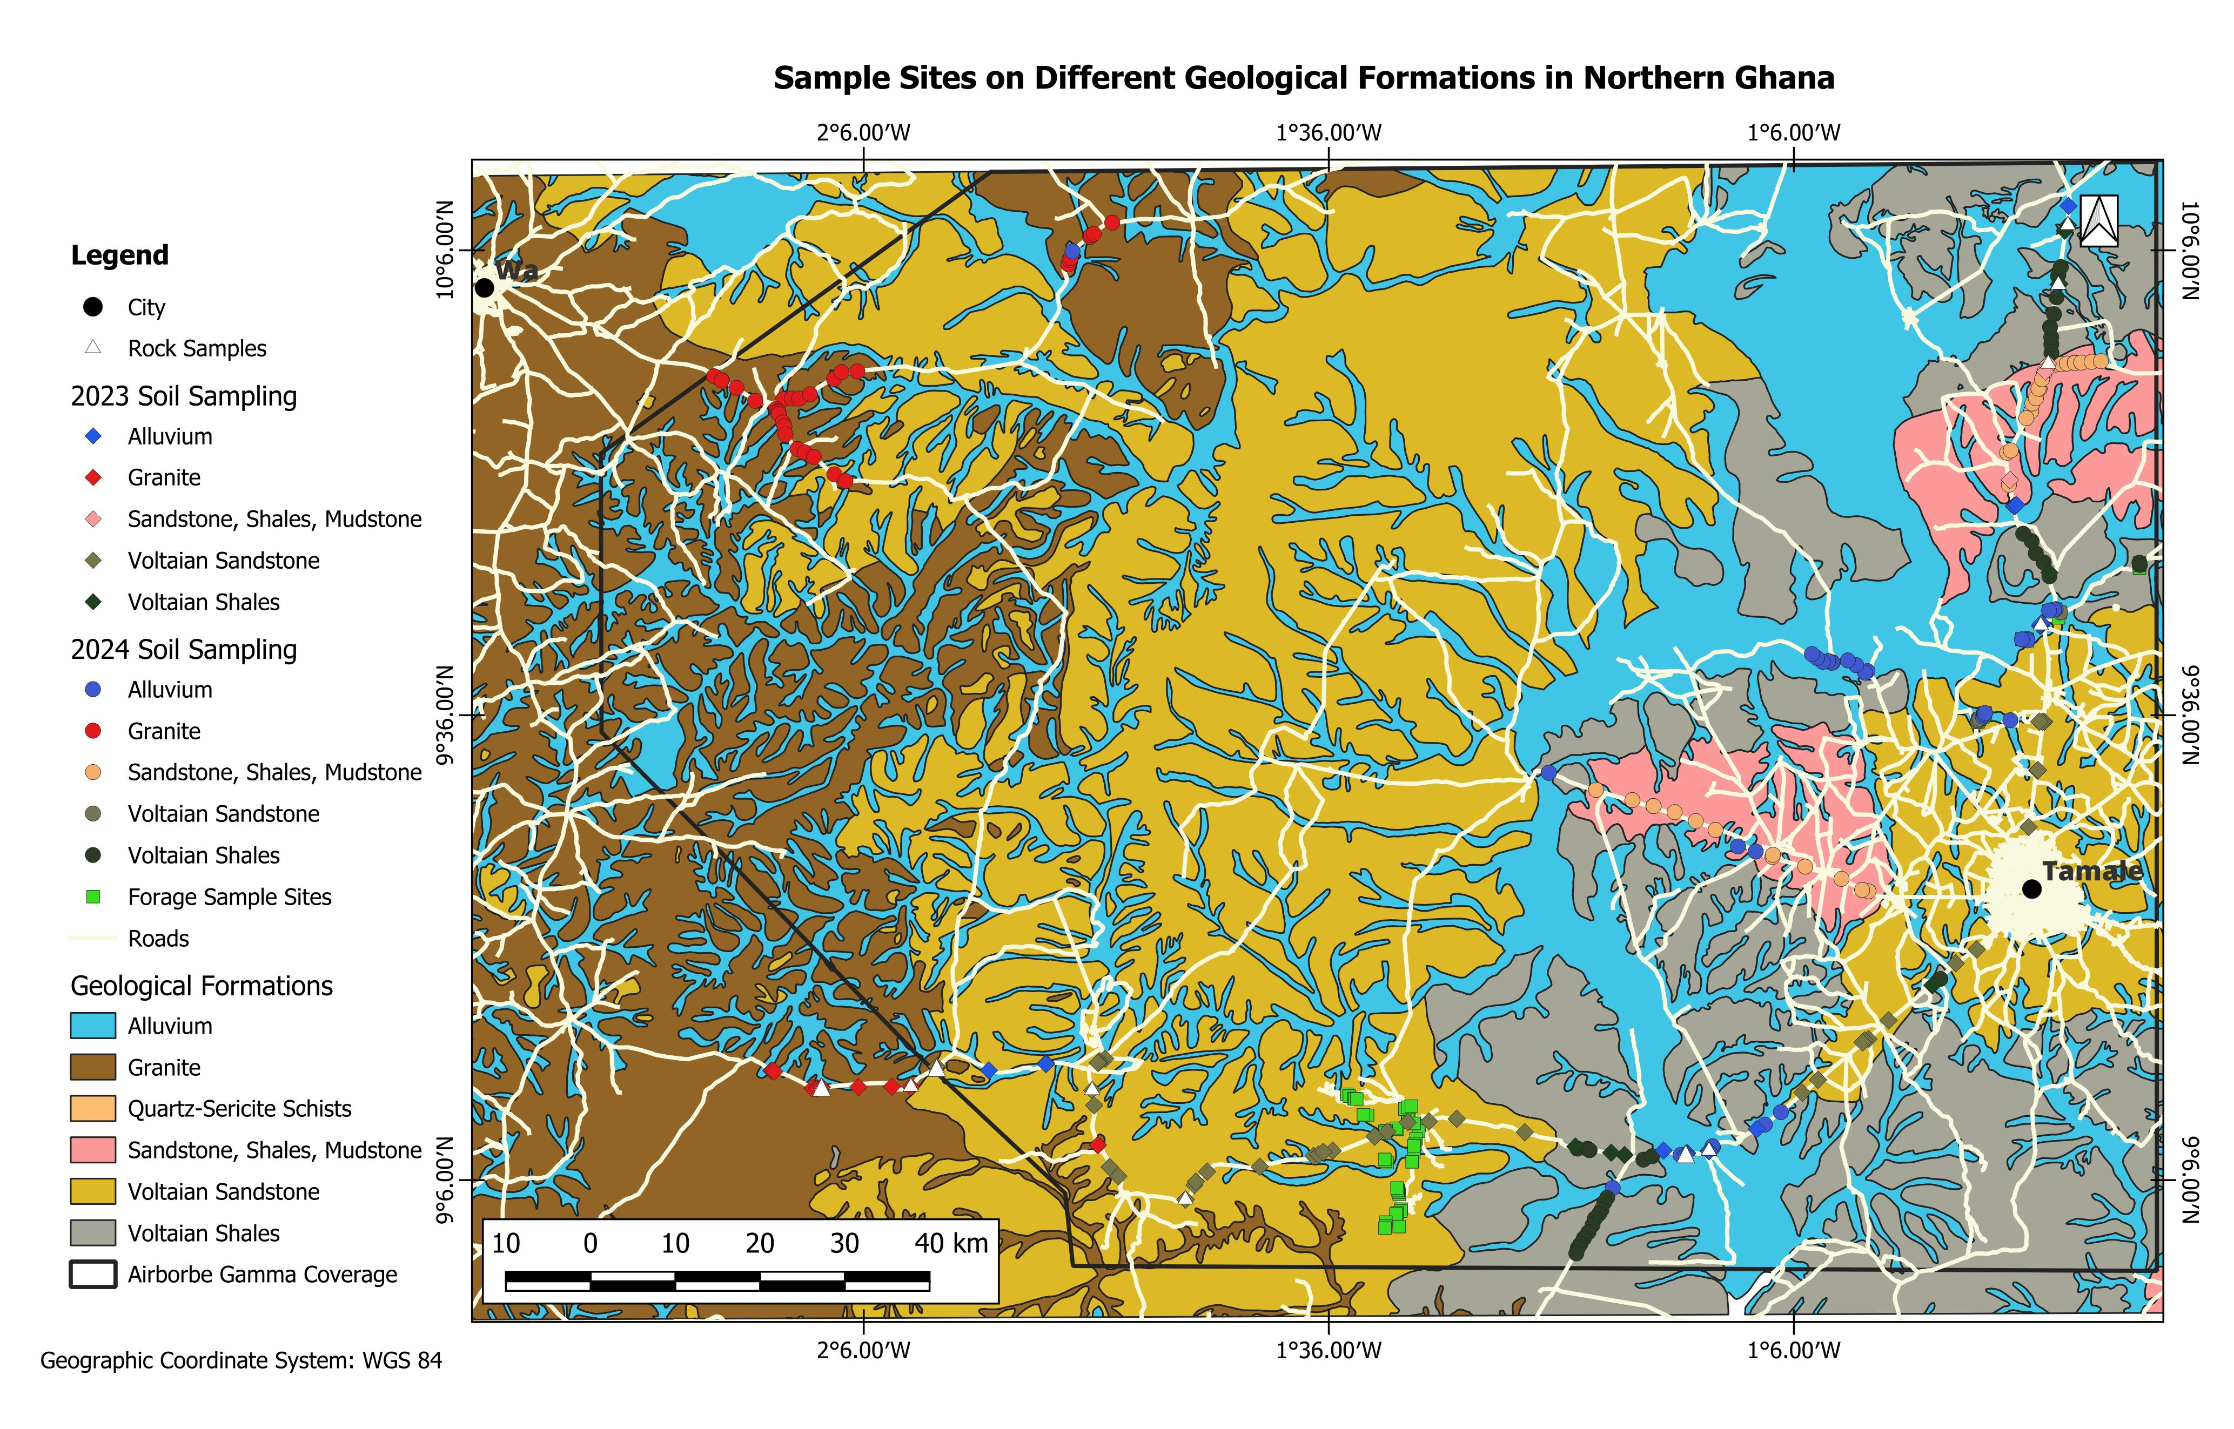
Micronutrient Chain Assessment in Northern Ghana
93 soil and rock samples were collected in 2023.
In 2024,
Up to 30 soil samples were taken per geological formations (at 3 depths)
Forage also taken at 55 sites in the region.
Statistical analysis of available data is ongoing
The chart show a very strong correlation between U and Cu

